Slide 1



GAME ANALYSIS:
Decoding Gaming Behavior
Presentation by Matthew Adenyo
Mentorness Internship | 2024 | Batch Name: MIP-DA-06

Slide 2
INTRODUCTION
This presentation covers task two of the Mentorness Internship Program.
It focused on working with a dataset related to a game. The dataset includes two tables: “Player Details” and “Level Details”.
The aim is to answer 17 questions by writing SQL queries.
Presentation by Matthew Adenyo | Mentorness Internship | 2024

Slide 3
PROBLEM STATEMENT
Players play a game divided into 3-levels (L0, L1 and L2)
Each level has 3 difficulty levels (Low, Medium, High)
At each level, players have to kill the opponents using guns/physical fight
Each level has multiple stages at each difficulty level.
A player can only play L1 using its system-generated L1_code.
Only players who have played Level 1 can possibly play Level 2 using its system-generated L2_code.
Presentation by Matthew Adenyo | Mentorness Internship | 2024

Slide 4
By default, a player can play L0.
Each player can login to the game using a Dev_ID.
Players can earn extra lives at each stage in a level.
Presentation by Matthew Adenyo | Mentorness Internship | 2024

Slide 5

DATASET DESCRIPTION
PLAYER DETAILS TABLE
LEVEL DETAILS TABLE
P_ID: Player ID
PName: Player Name
L1_status: Level 1 Status
L2_status: Level 2 Status
L1_code: System-generated Level 1 Code
L2_code: System-generated Level 2 Code
P_ID: Player ID
Dev_ID: Device ID
Start_time: Start Time
Stages_Crossed: Stages Crossed
Level: Game Level
Difficulty: Difficulty Level
Kill_Count: Kill Count
Headshots_Count: Headshots Count
Score: Player Score
Lives_Earned: Extra Lives Earned
Presentation by Matthew Adenyo | Mentorness Internship | 2024

Slide 6
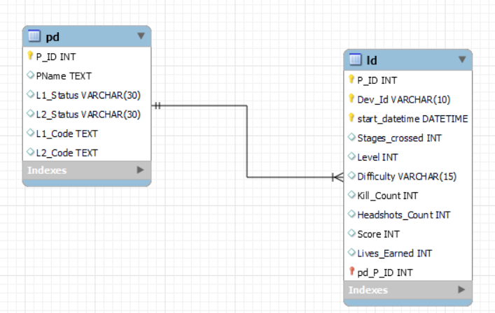
ENTITY RELATIONSHIP DIAGRAM
Presentation by Matthew Adenyo | Mentorness Internship | 2024

Slide 7

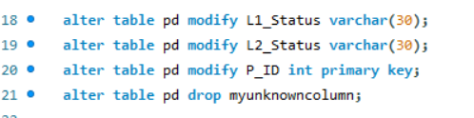
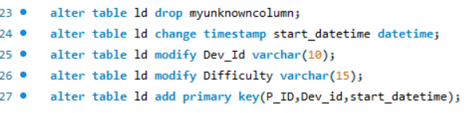
DATA CLEANING & TRANSFORMATION
To kick-start the analysis, I changed the table names, modified and dropped irrelevant columns.
Presentation by Matthew Adenyo | Mentorness Internship | 2024

Slide 8
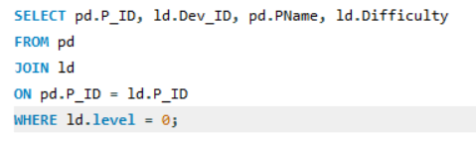
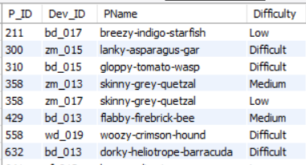
ANALYSIS: QUERIES & RESULTS
Q1) Extract P_ID, Dev_ID, PName and Difficulty_level of all players at level 0
Presentation by Matthew Adenyo | Mentorness Internship | 2024

Slide 9
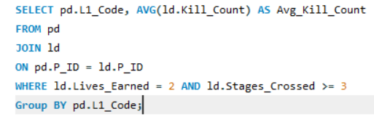
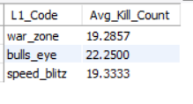
Q2) Find Level1_code wise Avg_Kill_Count where lives_earned is 2 and at least 3 stages are crossed
Presentation by Matthew Adenyo | Mentorness Internship | 2024

Slide 10
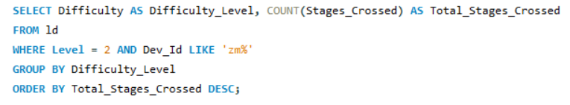

Q3) Find the total number of stages crossed at each difficulty level where for Level2 with players use zm_series devices. Arrange the result in decreasing order of total number of stages crossed.
Presentation by Matthew Adenyo | Mentorness Internship | 2024

Slide 11
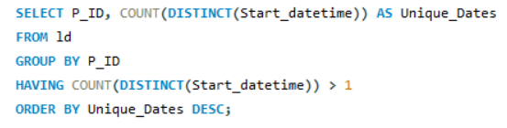
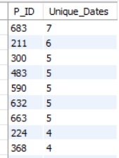
Q4) Extract P_ID and the total number of unique dates for those players who have played games on multiple days.
Presentation by Matthew Adenyo | Mentorness Internship | 2024

Slide 12
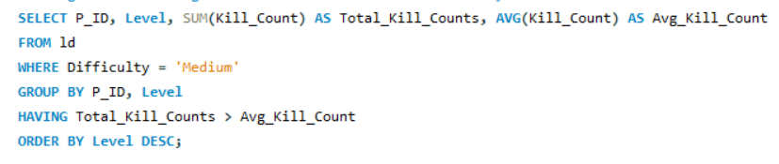
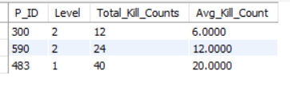
Q5) Find P_ID and level-wise sum of kill_counts where kill_count is greater than avg kill count for the Medium difficulty.
Presentation by Matthew Adenyo | Mentorness Internship | 2024

Slide 13
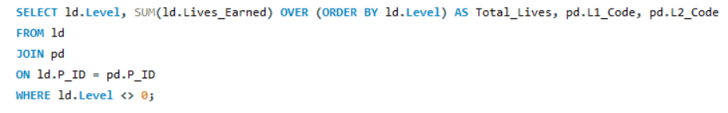
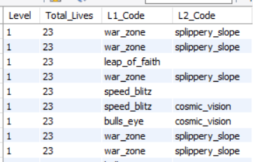
Q6) Find Level and its corresponding Level code-wise sum of lives earned excluding level 0. Arrange in ascending order of level.
Presentation by Matthew Adenyo | Mentorness Internship | 2024

Slide 14
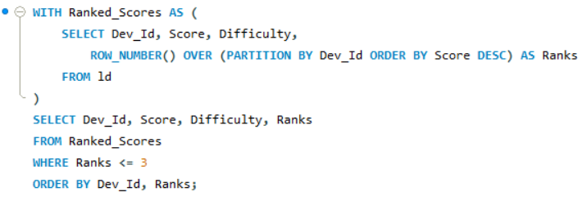
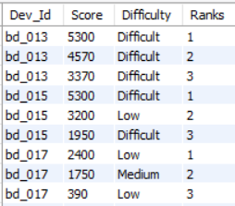
Q7) Find Top 3 score based on each dev_id and Rank them in increasing order using Row_Number. Display difficulty as well.
Presentation by Matthew Adenyo | Mentorness Internship | 2024

Slide 15

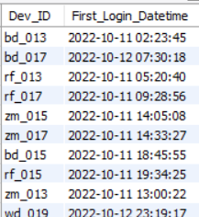
Q8) Find first_login datetime for each device id
Presentation by Matthew Adenyo | Mentorness Internship | 2024

Slide 16
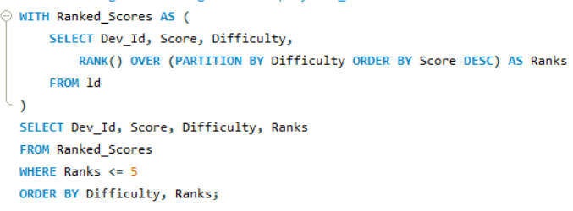
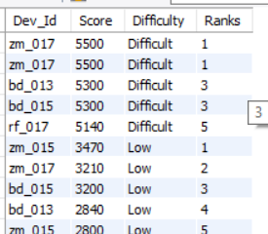
Q9) Find Top 5 scores based on each difficulty level and Rank them in increasing order using Rank. Display dev_id as well.
Presentation by Matthew Adenyo | Mentorness Internship | 2024

Slide 17
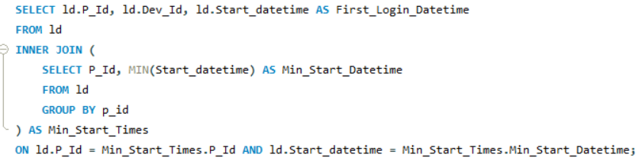
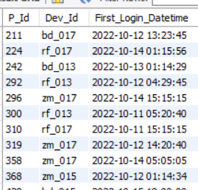
Q10) Find the device ID that is first logged in(based on start_datetime) for each player(p_id). Output should contain player id, device id and first login datetime.
Presentation by Matthew Adenyo | Mentorness Internship | 2024

Slide 18
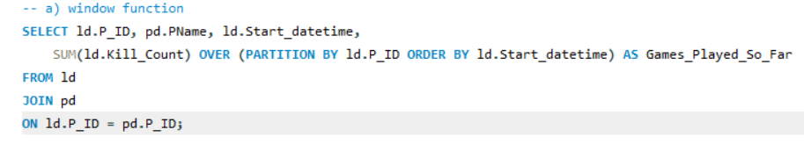
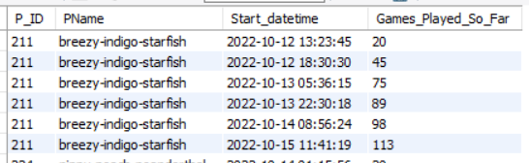
Q11) For each player and date, how many kill_count played so far by the player. That is, the total number of games played -- by the player until that date.
a) window function
b) without window function
Presentation by Matthew Adenyo | Mentorness Internship | 2024

Slide 19
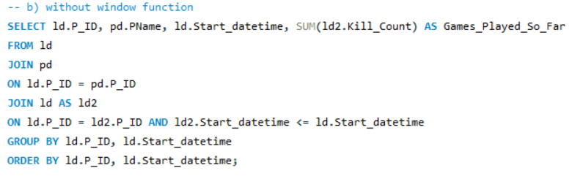
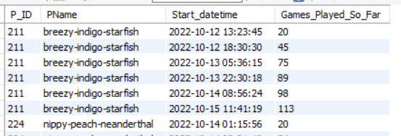
Presentation by Matthew Adenyo | Mentorness Internship | 2024

Slide 20
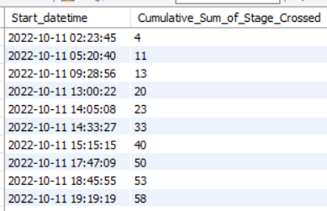
Q12) Find the cumulative sum of stages crossed over a start_datetime
Presentation by Matthew Adenyo | Mentorness Internship | 2024

Slide 21
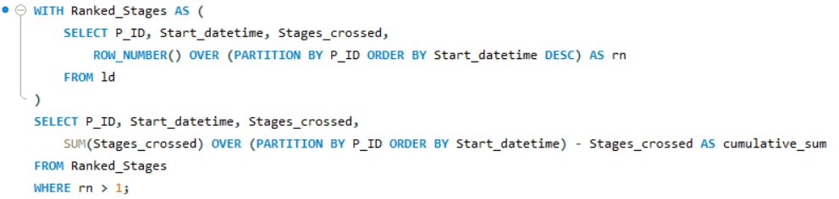
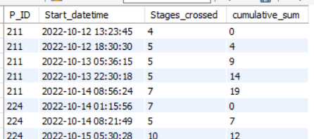
Q13) Find the cumulative sum of an stages crossed over a start_datetime for each player id but exclude the most recent start_datetime
Presentation by Matthew Adenyo | Mentorness Internship | 2024

Slide 22
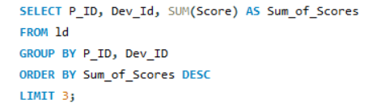
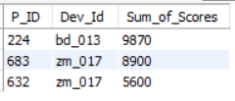
Q14) Extract top 3 highest sum of score for each device id and the corresponding player_id
Presentation by Matthew Adenyo | Mentorness Internship | 2024

Slide 23
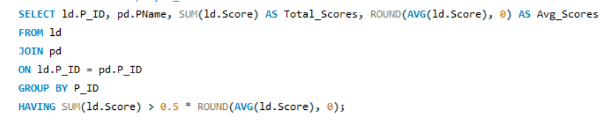
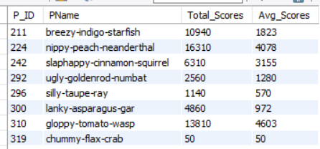
Q15) Find players who scored more than 50% of the avg score scored by sum of scores for each player_id
Presentation by Matthew Adenyo | Mentorness Internship | 2024

Slide 24
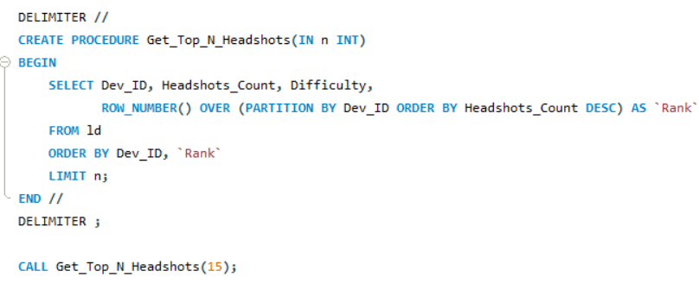
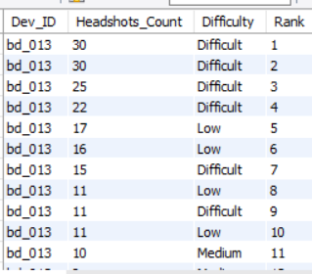
Q16) Create a stored procedure to find top n headshots_count based on each dev_id and Rank them in increasing order. using Row_Number. Display difficulty as well.
Presentation by Matthew Adenyo | Mentorness Internship | 2024

Slide 25
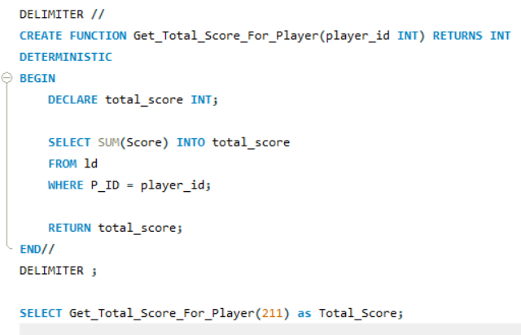

Q17) Create a function to return sum of Score for a given player_id.
Presentation by Matthew Adenyo | Mentorness Internship | 2024

Slide 26
CONCLUSION
The analysis of the game data using SQL has provided valuable insights into various aspects of the game's performance and player behaviour. By querying and manipulating the data, I was able to uncover trends and patterns that shed light on key aspects of the game.
KEY AREAS COVERED:
Sub-Queries
Aggregate Functions
Window Functions
Store Procedure
Presentation by Matthew Adenyo | Mentorness Internship | 2024

Slide 27
THANK YOU
Presentation by Matthew Adenyo
Your paragraph text
Mentorness Internship | 2024

